Slide 1
Welcome to Section 2 – Introduction to AI and ML in Plant Pathology
Ashish Adhikari
Jacobo Robledo

Slide 2
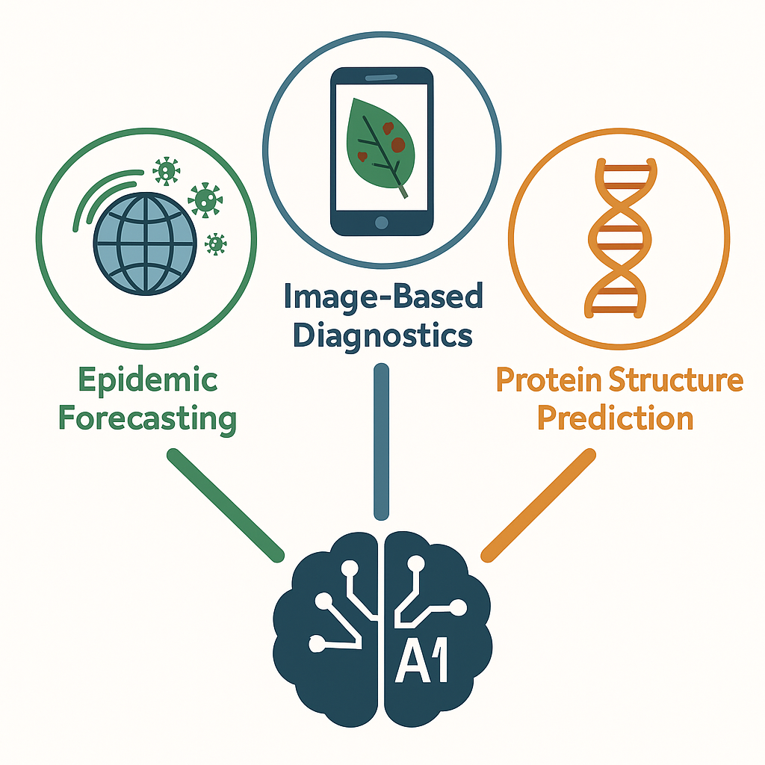
Session Goals
Demystify core AI/ML concepts used later today
See how Random Forests, CNNs & AlphaFold3 map onto real plant‑health problems
Set up tools (R, Python/Colab) so you’re ready for the hands‑on sessions (document)

Slide 3
Why AI for Plant Pathology?
Climate change + trade → faster, larger epidemics
Data explosion: remote sensing, genomic & image data
AI/ML can extract patterns humans miss and scale decision support
Three high‑impact domains we tackle today:
Epidemic forecasting
Image‑based diagnosis
Protein‑structure prediction

Slide 4
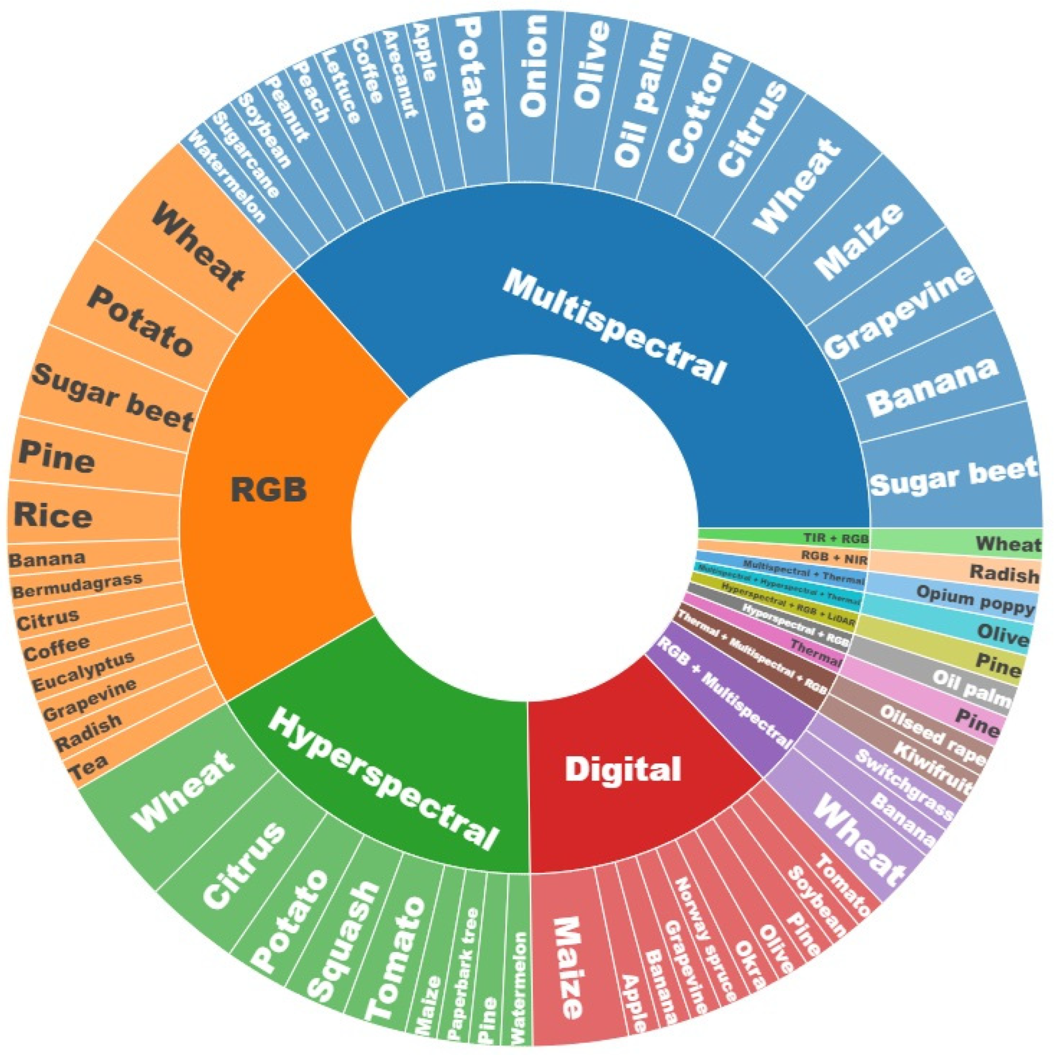
Plant Pathology and ML/AI! Why now?
Big jump in data volume
Climate rasters: 1 km global raster stacks updated monthly (CHELSA, ERA5)
Drone imagery: Field scouting has been supplemented by UAV
Genomics: Sequencing costs
Decision‑making bottleneck for disease management
Automating pattern recognition accelerates insights
Kouadio, Louis, et al. "A review on UAV-based applications for plant disease detection and monitoring." Remote Sensing 15.17 (2023): 4273.

Slide 5
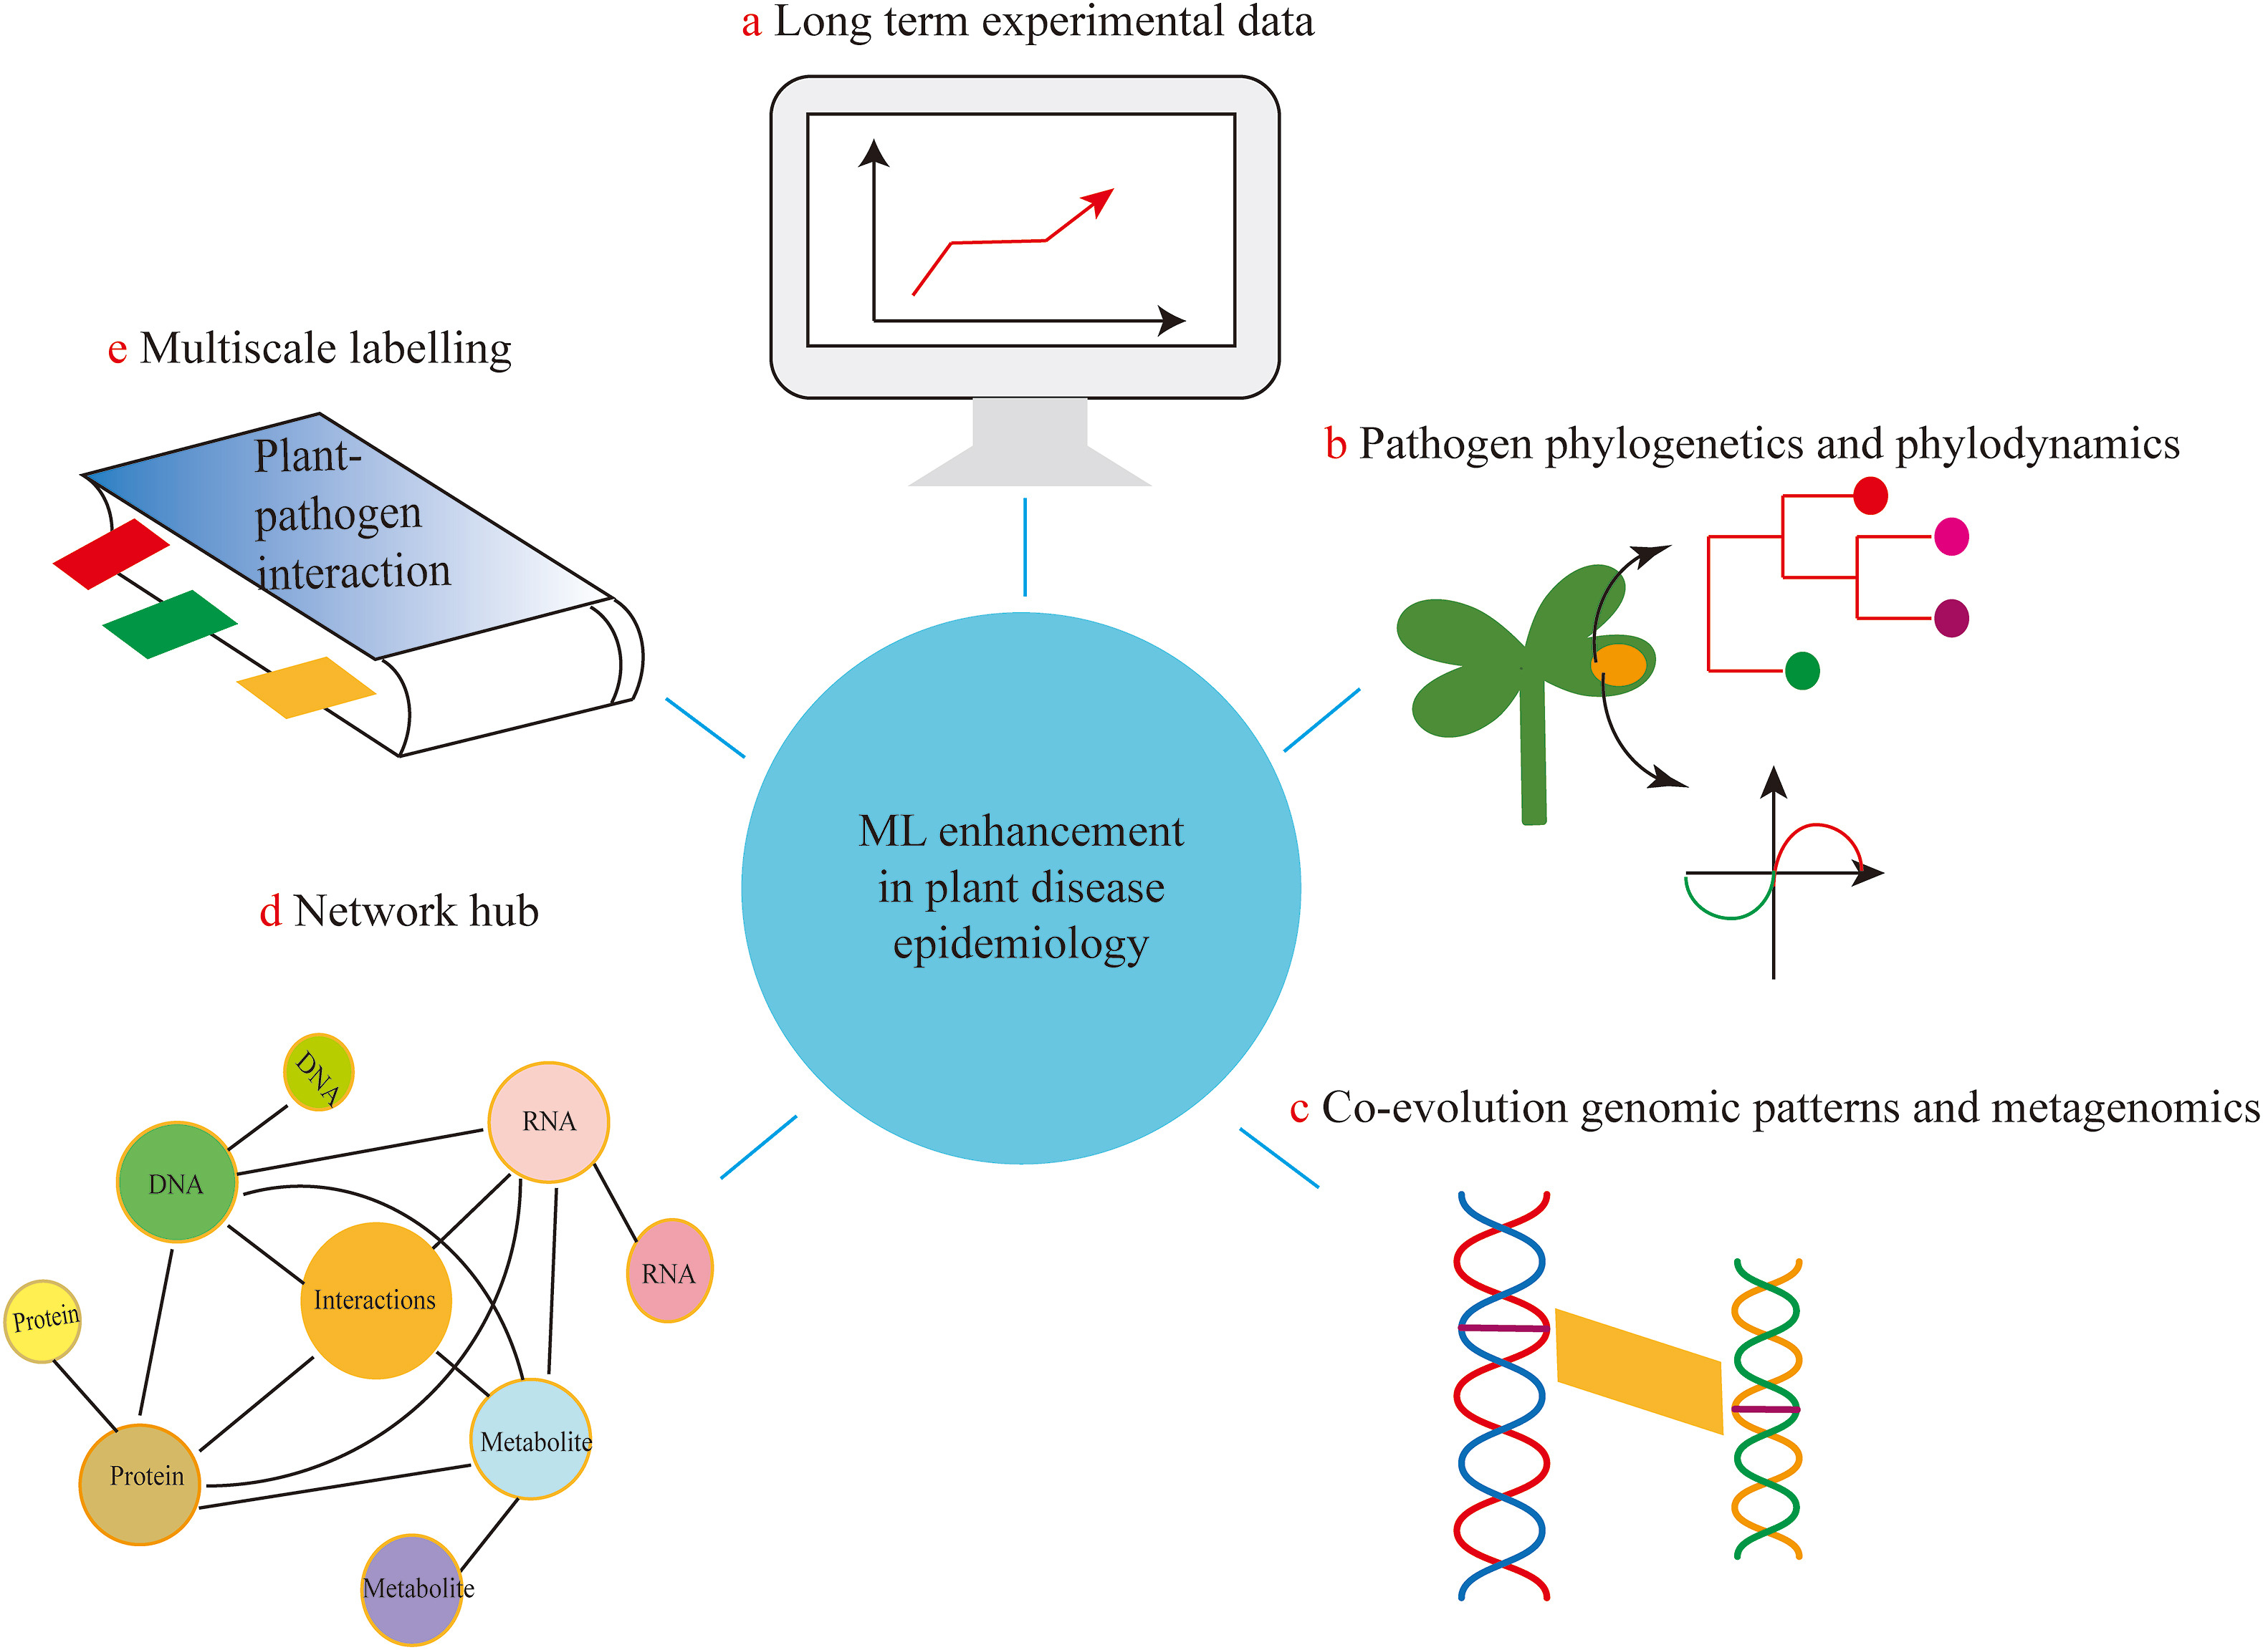
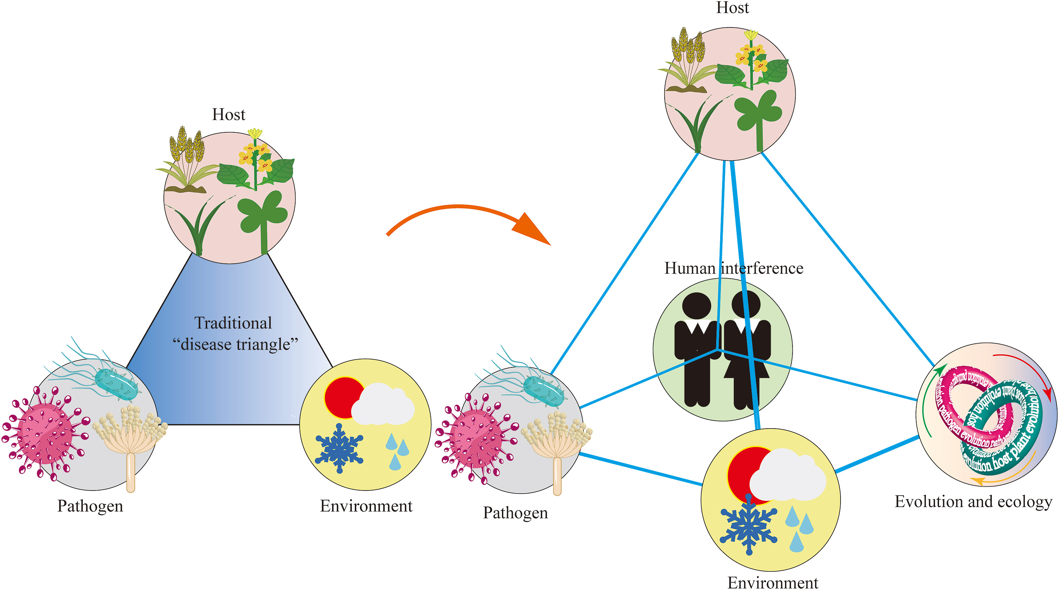
Plant Pathology and ML/AI! Why now?
Neik, Ting Xiang, et al. "Plant Disease Epidemiology in the Age of Artificial Intelligence and Machine Learning." Agriculture Communications (2025): 100089.

Slide 6
Key Definitions
Term | Short definition
Artificial Intelligence | Any technique that enables computers to mimic human intelligence
Machine Learning | Sub‑field of AI that learns patterns from data
Deep Learning | ML using multi‑layer neural networks
Data Science | End‑to‑end process: collect → clean → model → communicate

Slide 7
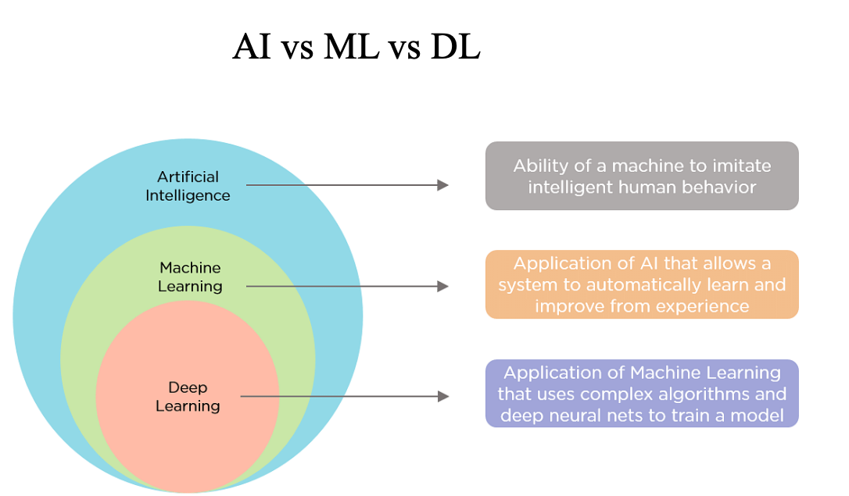
What is Machine Learning?
Algorithms learn patterns from data rather than explicit rules.
Handles hundreds of predictors & nonlinear interactions
Reduces manual feature crafting
Complements—not replaces—epidemic models (e.g., SEIR)
Emphasis on prediction rather than understanding mechanisms
Example: AI can power a mobile app that recognizes crop diseases from a photo.

Slide 8
Types of Machine Learning
Supervised (labeled data → prediction) e.g. Random Forest predicting rust incidence
Unsupervised (find structure in unlabeled data) e.g. clustering microbiome OTUs
Reinforcement (learning by trial & reward) less common in plant pathology – examples in autonomous greenhouse control
Focus today: supervised & deep learning.

Slide 9
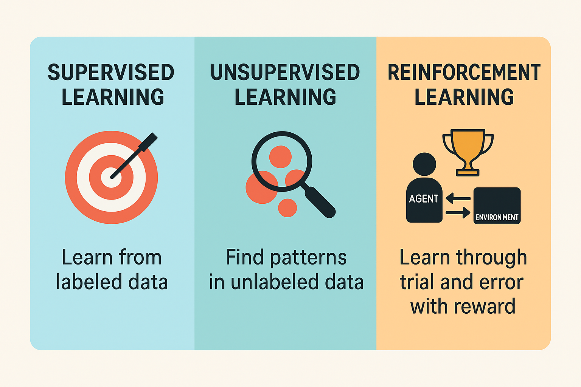

Slide 10
Supervised Learning Spotlight: Random Forest (RF)
Ensemble of decision trees → vote/average
Handles non‑linearities & high‑dimensional data
Gives feature importance (useful for epidemiology)
We’ll tune RF models in Session 3.

Slide 11
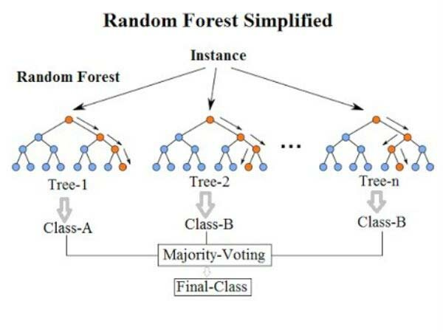

Slide 12
A Note on Unsupervised Learning
PCA/t‑SNE/UMAP for dimensionality reduction
K‑means & hierarchical clustering for grouping isolates or field sites
Not covered hands‑on today but powerful for exploratory stages

Slide 13
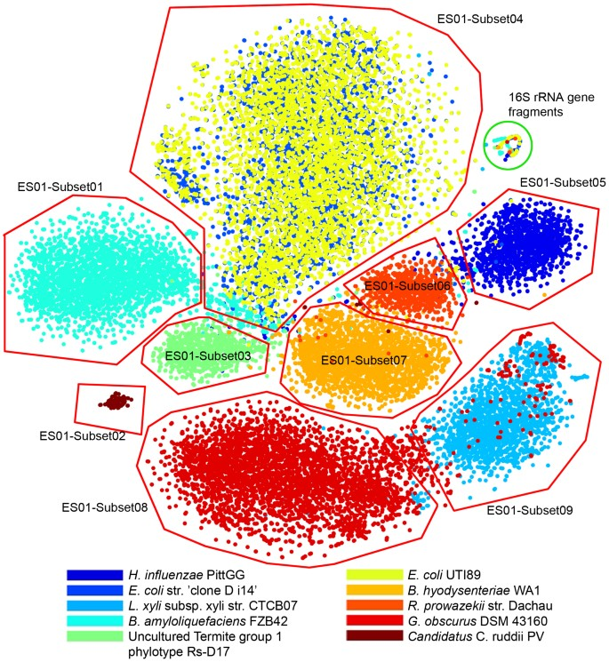

Slide 14
Classification
Goal: Predict categorical labels (discrete classes).
Output: Class labels (e.g., spam or not spam, disease or no disease).
Target Variable: Nominal or Ordinal.
Algorithms:
Logistic Regression
Decision Trees
Random Forest
SVM (for classification)
KNN
Evaluation Metrics: Accuracy, Precision, Recall, F1 Score, ROC-AUC

Slide 15
Regression
Goal: Predict continuous numerical values.
Output: Real numbers (e.g., house price = $450,000).
Target Variable: Continuous/Real-valued.
Algorithms:
Linear Regression
Ridge/Lasso Regression
SVR (Support Vector Regression)
Random Forest Regressor
Evaluation Metrics:
Mean Absolute Error (MAE)
Mean Squared Error (MSE)
R² Score

Slide 16
Deep Learning in a Nutshell
Neural networks = layers of weighted sums + nonlinearities
Convolutional Neural Networks (CNNs) excel on images
Transformers (attention) underpin AlphaFold3
Require large datasets & GPUs → we’ll use Google Colab

Slide 17
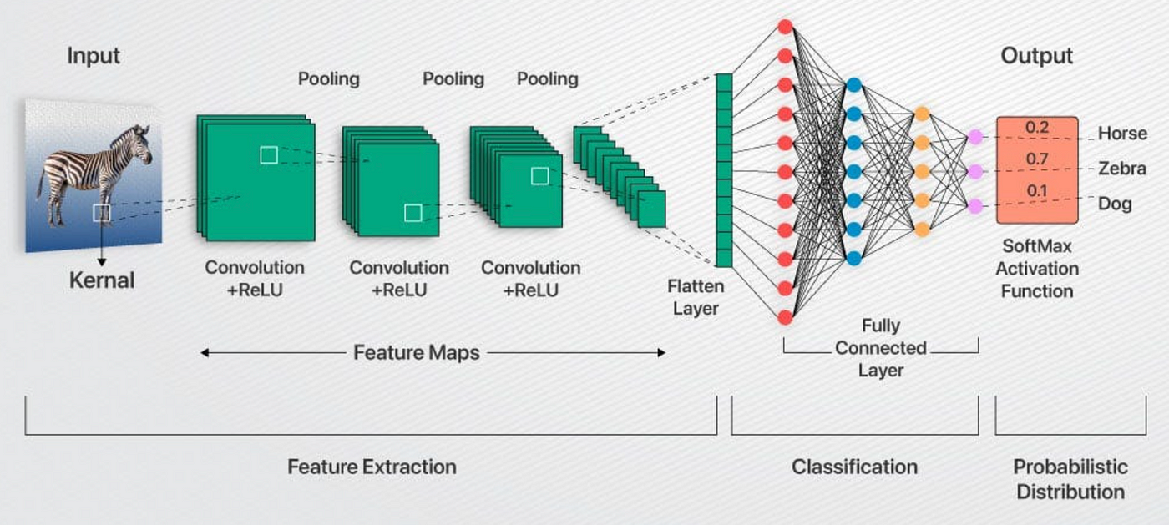

Slide 18
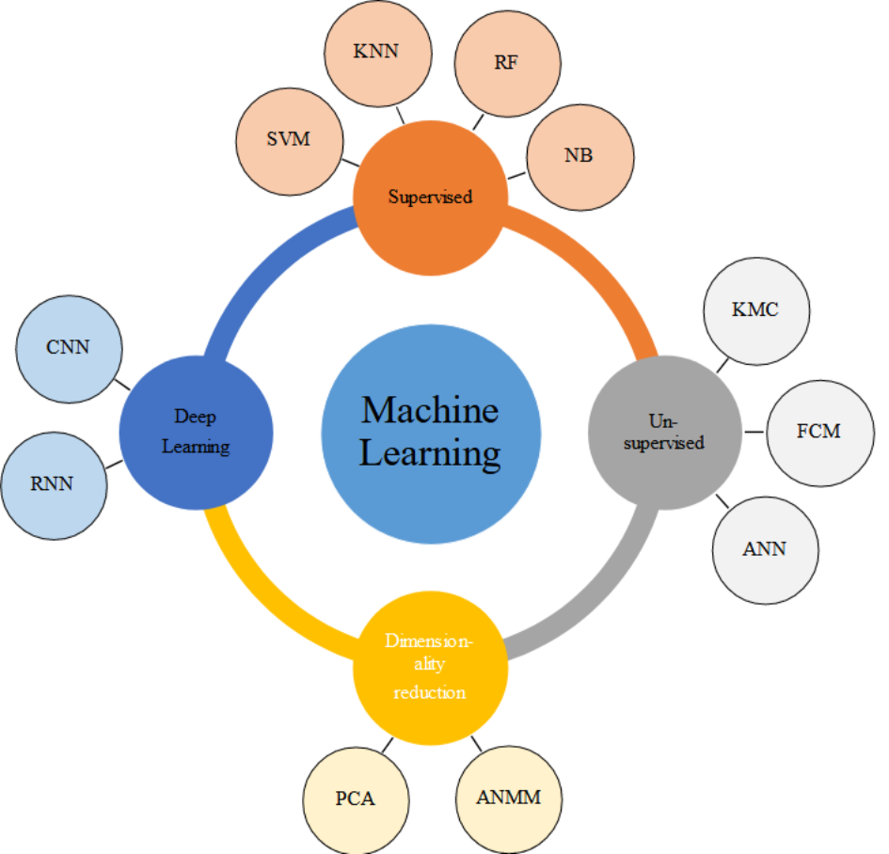
Examples ML algorithms:
KNN – K-Nearest Neighbors
RF – Random Forest
NB – Naive Bayes
SVM – Support Vector Machine
CNN – Convolutional Neural Network
RNN – Recurrent Neural Network
KMC – K-Means Clustering
FCM – Fuzzy C-Means
ANN – Artificial Neural Network
PCA – Principal Component Analysis
ANMM – Average Neighborhood Margin Maximization

Slide 19
Generic ML Workflow (Pipeline)
Data ingestion & cleaning
Feature engineering / selection
Model training & cross‑validation
Hyper‑parameter tuning
Evaluation & interpretation
Deployment / decision support
Session 3 drills into steps 2‑4; Sessions 4 & 5 focus on steps 3‑5

Slide 20
Tool Stack for the Workshop
Domain | Language | Key packages/tools
Epidemic forecasting | R | tidymodels, randomForest, caret
Image classification | Python | PyTorch, TensorFlow (Keras), PlantVillage dataset
Protein prediction | Python | AlphaFold 3 (DeepMind), ColabFold
Compute | Cloud | Google Colab GPUs
Ensure your Colab notebook connects to GPU before Session 4.

Slide 21
Impact 1: Epidemic Forecasting with RF
RF + weather & host data predicted wheat stripe rust 1–2 weeks ahead with >91 % ROC‑AUC (sciencedirect.com)
UAV hyperspectral + RF enabled early rust detection before visual symptoms (sciencedirect.com)
Decision dashboards help extension agents time fungicide sprays.
Figure idea: ROC curve & map of predicted risk.

Slide 22
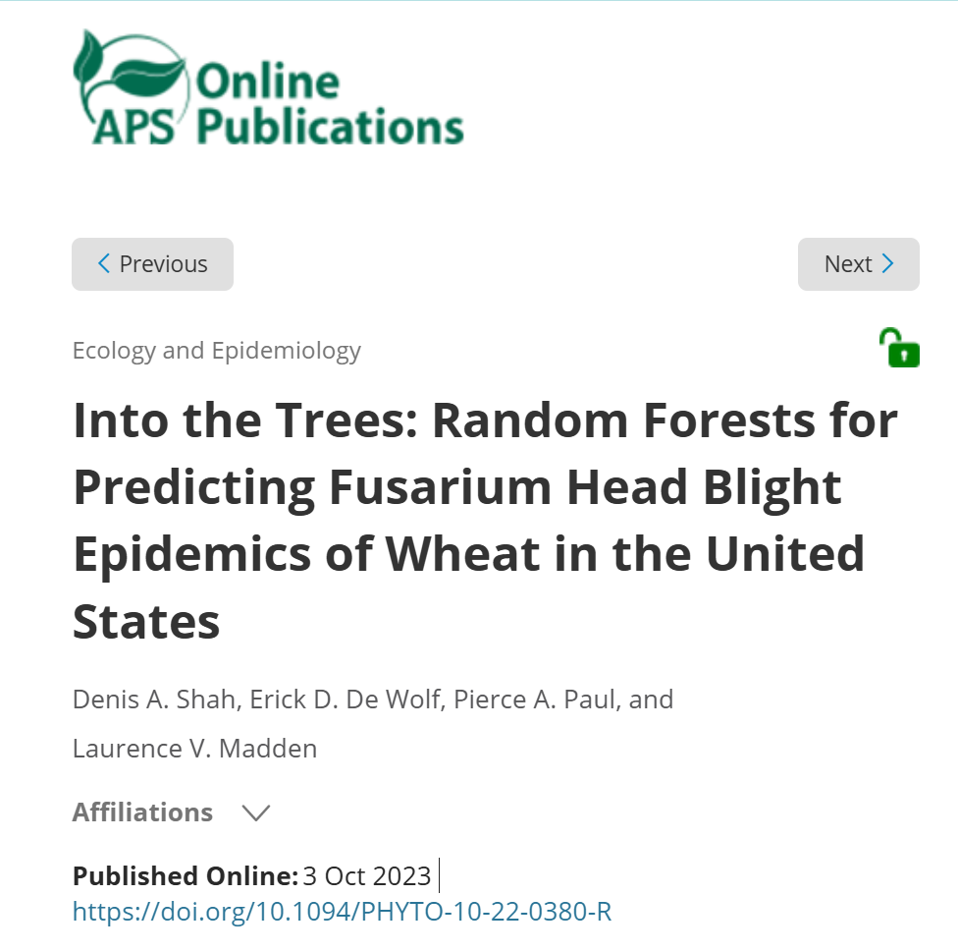

Slide 23
Impact 2: Image‑Based Diagnostics
PlantVillage CNN models exceed 99 % accuracy on 38 crop–disease classes (sciencedirect.com, link.springer.com)
Smartphone apps now diagnose foliar diseases in the field within seconds (e.g. cassava, tomato) (sciencedirect.com)
Benefits: democratizes expertise, supports smallholder farmers.
Figure idea: phone screenshot with predicted class & confidence.

Slide 24
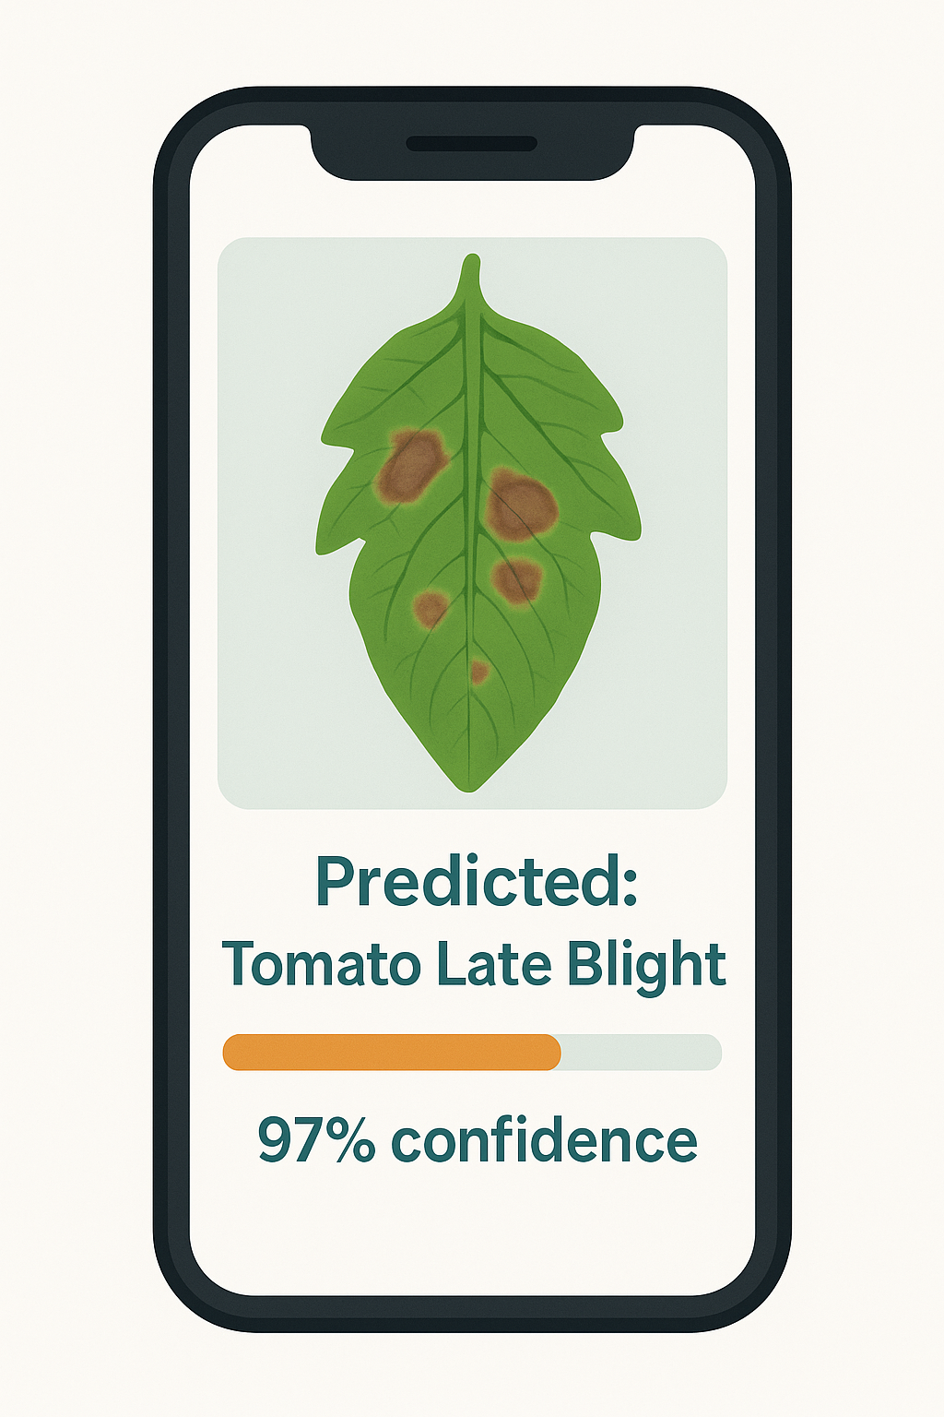

Slide 25
Impact 3: Protein & Effector Prediction
AlphaFold (2) resolved >26 k secreted proteins from 14 fungal pathogens, revealing novel effector folds (nature.com)
AlphaFold (2)‑Multimer predicted cross‑kingdom effector–protease interactions (nature.com)
Recent NLR–effector complex models accelerate resistance gene discovery (pmc.ncbi.nlm.nih.gov)

Slide 26
Benefits vs Limitations
Benefits
High predictive accuracy
Handles complex, non‑linear interactions
Scales to big data & real‑time inference
Limitations
Data‑hungry & compute‑intensive
Interpretability challenges (esp. deep models)
Risk of bias / domain shift
Reproducibility & maintenance burden

Slide 27

Responsible AI in Plant Health
Data privacy & sharing across borders
Model transparency (SHAP, Grad‑CAM)
Benchmarking & open‑science culture
Equity: ensuring smallholder benefits

Slide 28
Looking Ahead to Hands‑On Sessions
Session | Skill you’ll practice
3 | Cleaning data, feature importance, RF tuning
4 | Building & tuning CNNs for diagnosis
5 | Running AlphaFold3 & interpreting structures
Prep check:
Verify R & Python notebooks open
GPU connection in Colab OK
Downloaded datasets? (~5 GB; link in email)

Slide 29
Q&A
What challenges have you faced applying AI in plant pathology?

